Slide 1


Quantitative Methods + Qualitative Analysis = Superior Returns

Slide 2

Who & What
FatAlpha is:
  Value investing approach
  Develop initially for my personal investment needs
  Currently also offered to investors and funds.
  Operate out of Cyprus. Under the regulatory umbrella of the Cyprus Development Bank.
The Approach
Quantitative value models used to screen for opportunities.
  Alleviates the problem of investment biases. Helps provide focus.
  Factors used in models were either from or based on theory from academic papers & books.
  The models and each individual factor was backtested
Fundamental analysis is done on the model output.
Best opportunities are invested in.
Summary of logic: Market < Value Models < FatAlpha (Qualitative Overlay)
FatAlpha Active Strategy
  From inception mid-2012 to March 2016: gross 165% vs 89% for market.

Slide 3

Long Idea
(Ticker: BBBY)

Slide 4



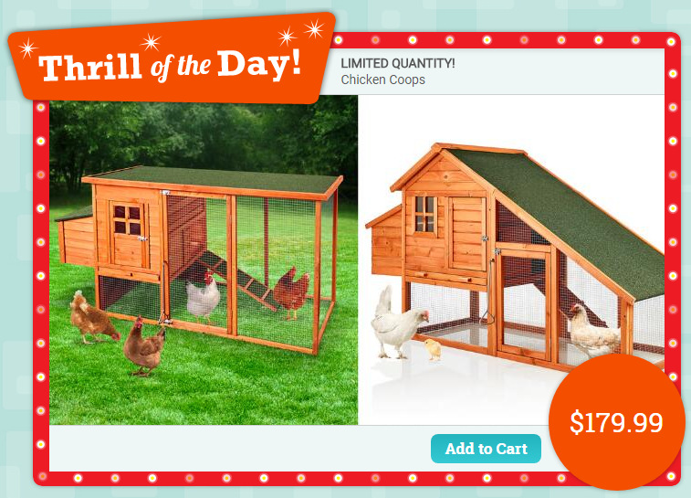

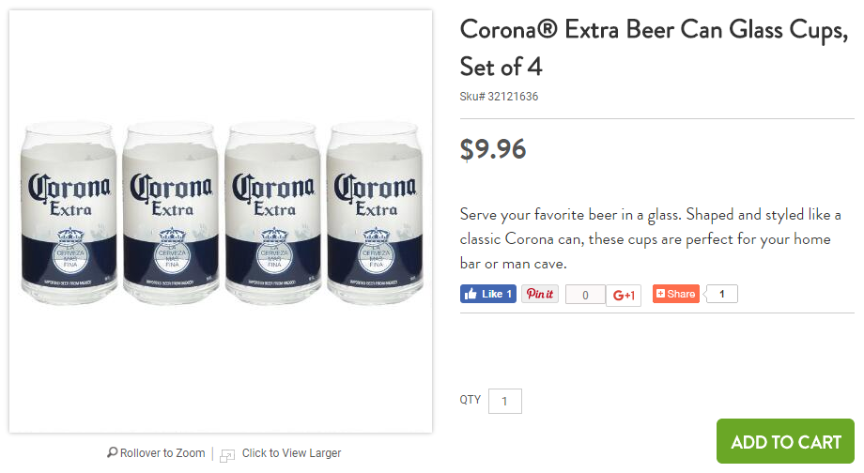






The Company
A retail giant with >$12Bn in sales (top 40 in US), >8 brands and >1500 stores.
1023 stores
276 stores
113 stores
80 stores
Household items.
Household items. Initially operated at Cost + 10% and sold ‘original’+handmade items. Acquired in 2012 for $495m.
Everything for babies & young children. Acquired in 2007 for $65m.
Holiday/Seasonal items, discounted items on closeout/overstock merchandise, “unique” items. Acquired in 2003 for $200m.
Vs $26.49 on Amazon.com
Home décor website Acquired <$30m in 2016. Initially a “flash sales” site of upscale furniture & home décor, valued at $900m at 2014 funding. To open it’s first shop in the Hamptons on Memorial day (May 29).
54 stores
Personalized gifts website Acquired in ‘16 for $190m.
Cosmetics, health & beauty retailer.
Unique limited production pieces from new designers (>300).
Linen Holdings
Textile Distributor to institutional clients.

Slide 5
Decent Fundamentals
Every year over the last 25 years: Sales have grown, Double digit EBITDA margins (12%)
Double digit ROA, ROE, ROIC
Positive Free Cash Flow since 1996 (LTM FCF margin 5.5%, FCF/EV 10%)
Investor friendly: 15c div per qtr (1.5% yield), only 13% payout (can grow), $7bn returned to shareholders over last 5 years. $1.7 bn buyback program remaining.
Low debt levels. Debt-free until 2013. Current debt due 2024, 2034, 2044
  Bond Rating: BBB+, Baa1
  Debt: $1.5 bn, EBITDA: $1.4 bn, Debt/EBITDA: 1.0x
  Debt/Equity: 0.55, Z-Score: 5.75, F-Score: 5
  Leases: $3.3 bn, Debt + Leases / EBITDA: 3.3x

Slide 6
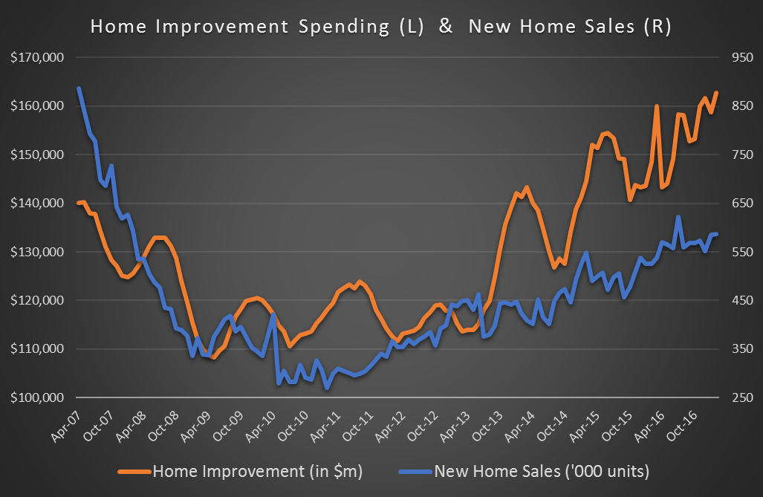
Retail Sales – Home Furnishing
Home Furnishing has grown at a slower pace than New Home Sales
BBBY sales growth < Home Furnishing over last 3 years.
WSM also underperformed in last year
Note Size of BBBY – 11% of market
Size allows it to aggressively negotiate terms with suppliers
Allows company to have lenient return policy & lower prices

Slide 7
Income Statement
10-year growth:
Sales: +6.3%
Operating Income: +2.5%
EPS: +7.8%
Avg Dil Shrs: -6.2%
5-year growth:
Sales: +5.2%
Operating Income: -6.3%
EPS: +2.4%
Avg Dil Shrs: -9.3%

Slide 8
EBITDA Margins
EBITDA Margins

Slide 9
Same Store Sales
Same Store Sales (Last 5 Quarters)
Take away: BBBY’s +1 / -1 fluctuation is not too worrisome

Slide 10
Retail Problems: Online competition, Discounting
Company SEC Filings:
“Comparable sales consummated through customer facing digital channels increased
U.S. E-Commerce
Retail sales
+14 to +16%
according to the
U.S. Census Bureau
Vs

Slide 11
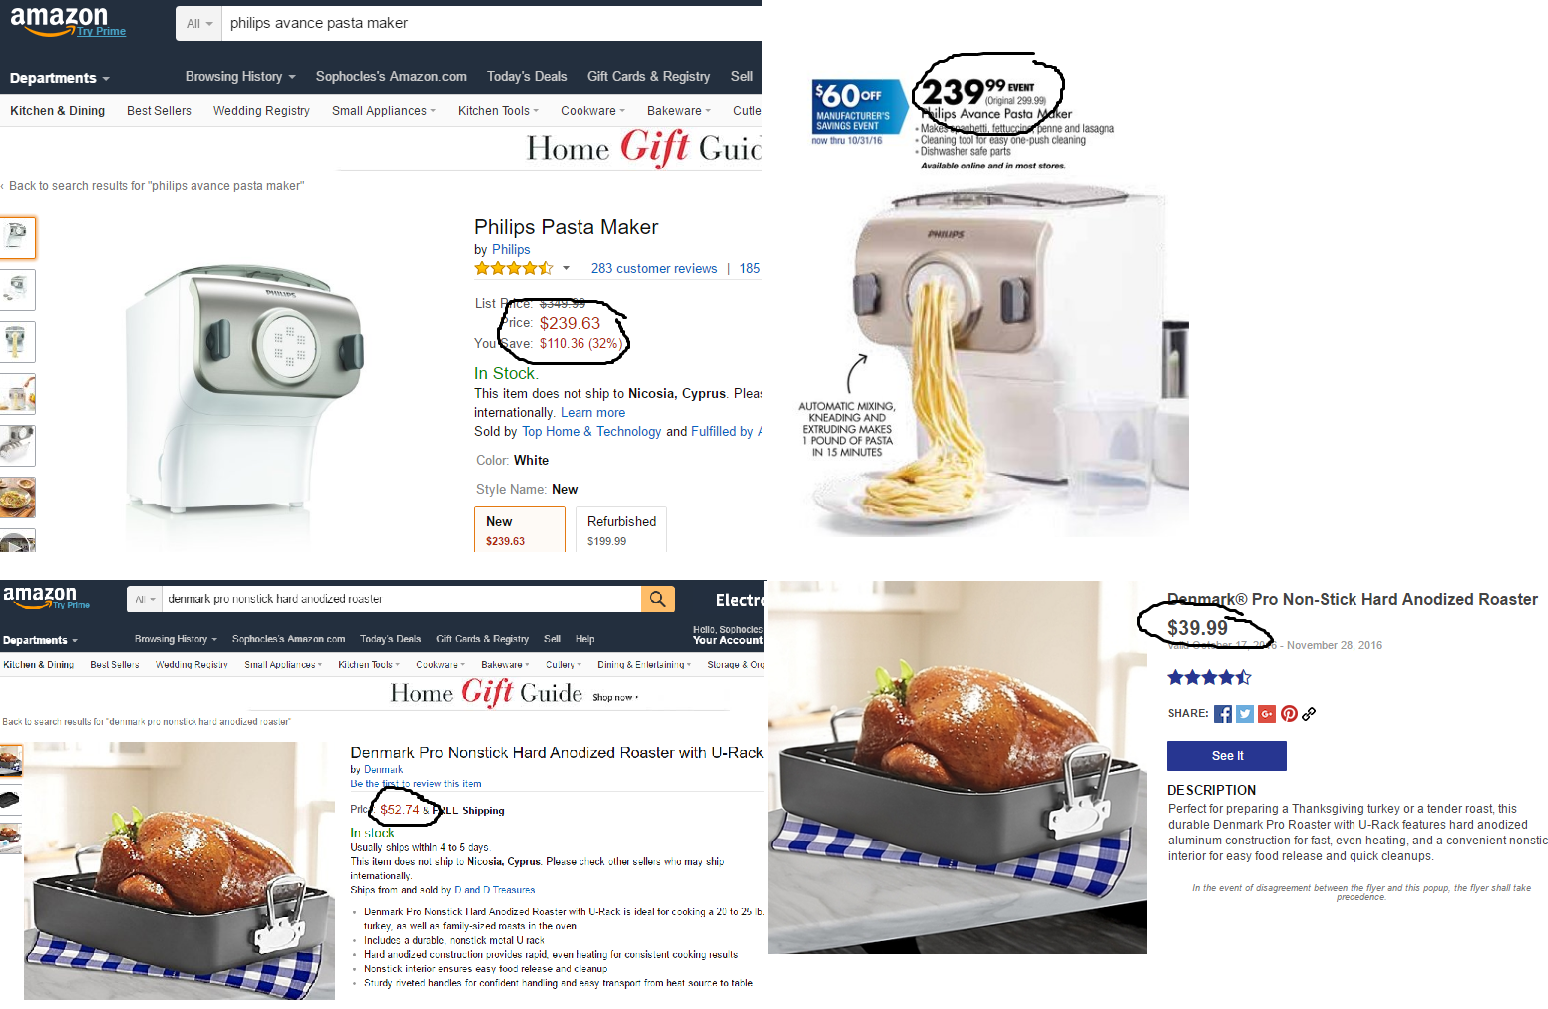
BBBY Versus Amazon – Study 1 – October 2016

Slide 12
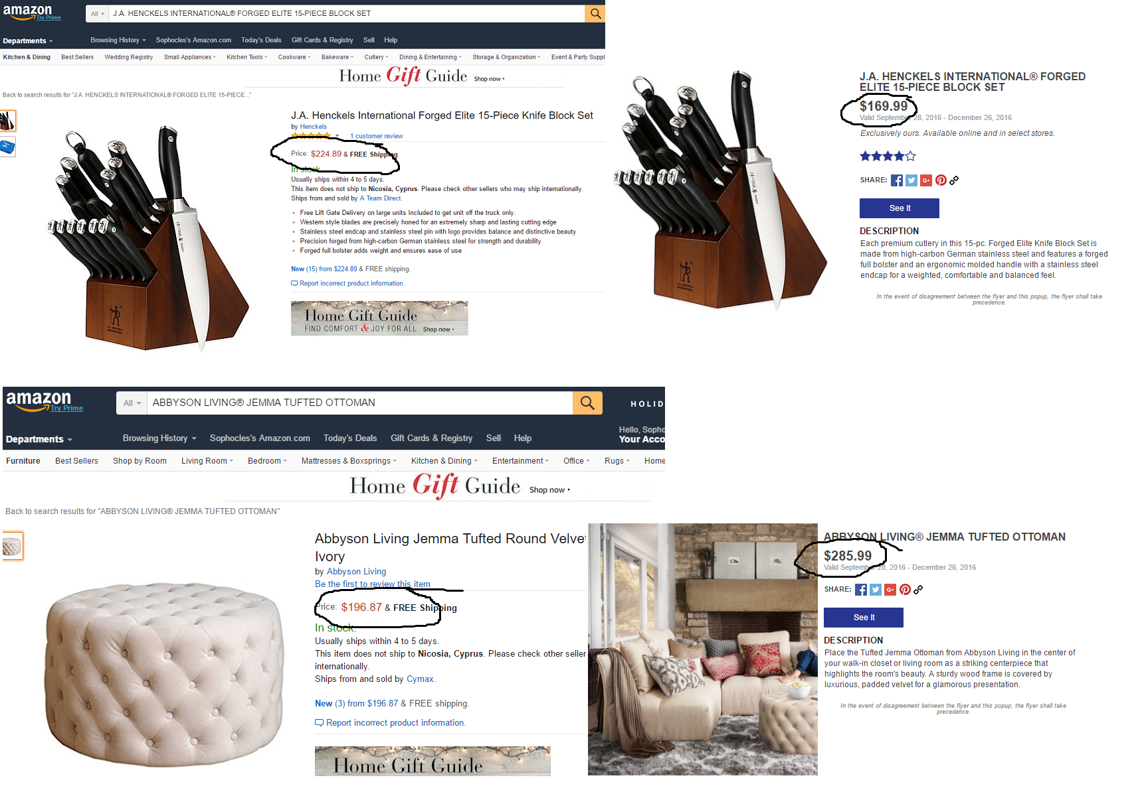
BBBY Versus Amazon – Study 1 – October 2016

Slide 13
BBBY Versus Amazon – Study 1 – October 2016
Could it be that BBBY was on par or even cheaper than Amazon?
Random basket of 40 items from BBBY website.
  20 items were cheaper at BBBY,
  18 items were cheaper at Amazon,
  2 items were equally priced.
  The average and median price was -1% and -2% respectively cheaper.
BBBY was cheaper than Amazon!
Sometimes… massively cheaper…

Slide 14
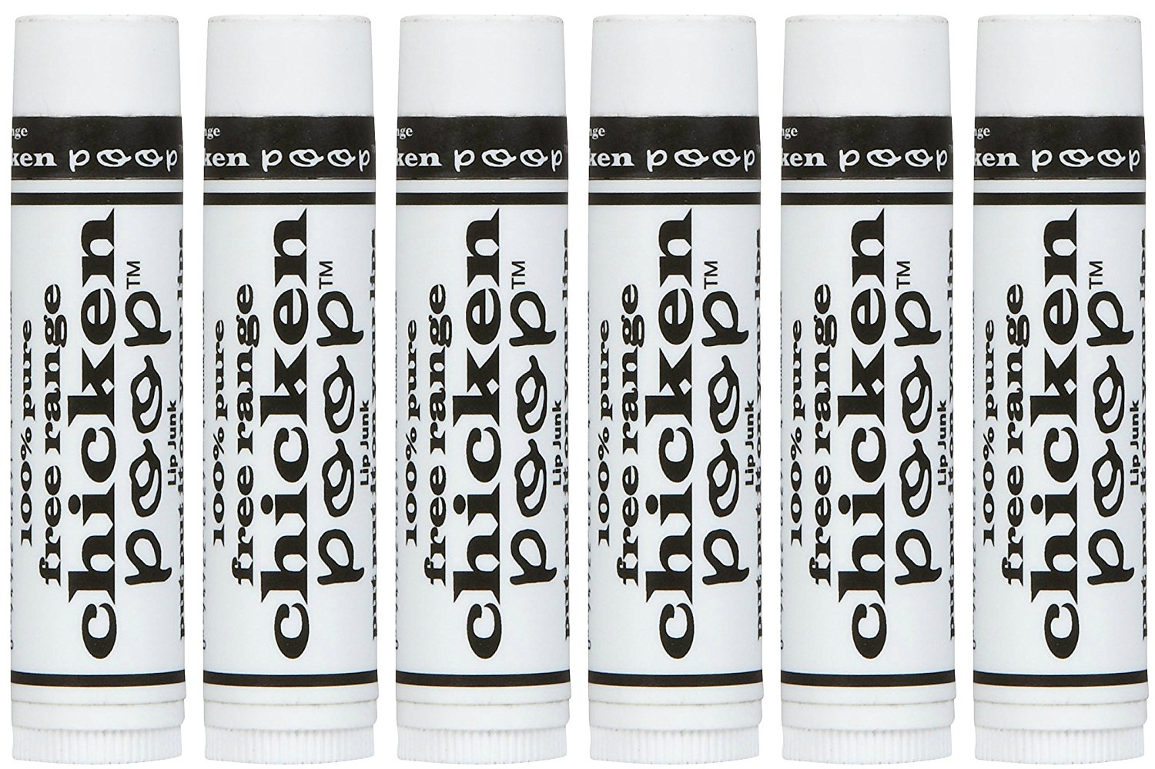
BBBY Versus Amazon
Free Range Chicken Poop lip balm $2.79 vs $6.61

Slide 15
BBBY Versus Amazon – Study 2 – April 2017
Repeat of exercise on April 14th.
  Expanded to 70 items across all main product categories listed on BBBY website.
  Selected items in accordance to order they appeared.
  Clearance items on BBBY website were NOT included.
  Excluded newly launched 3rd party Amazon sellers.
28 items were cheaper at BBBY,
33 items were cheaper at Amazon,
9 items were equally priced.
Average and median difference in price was 0%.
April 25th Update
  Used links to go to same products on both BBBY and Amazon.
  BBBY prices changed for 3 items only
30 items were cheaper at BBBY,
30 items were cheaper at Amazon,
10 items were equally priced.
Average and median price difference was -1% and 0% respectively.
E-MAIL for a copy: sophocles@fatalpha.com

Slide 16
BBBY Versus Amazon – Other Observations
Shipping isn’t much of an issue:
  Most home purchases qualify for free shipping due to high purchase price.
  BBBY offers free shipping for over $29 in purchases.
  Prime was only available on 22 / 70 products.
  None prime members would need to make $35 in purchases on certain items.
Coupons and new loyalty program (Beyond+) make a huge difference.
  BBBY is generous on distributing 20% off coupons.
  BBBY has honored coupons past expiry.
  New loyalty program: only $29 fee cost (free shipping & 20% off purchases).
CONCLUSION:
  BBBY prices are at worse on par with Amazon.
  Including coupons/Beyond+, BBBY is significantly CHEAPER!

Slide 17
Is it Cheap?
At < 10x P/E, <5x EV/EBITDA, BBBY is trading at a massive discount to the S&P 500!
Historical AvgEx Multiples: $55
Currently: Trading below -1 St Dev price ($44)
Zero-growth Perpetuity: $48
AvgEx Median Comparables: $50

Slide 18
Summary
One of the largest retailers in the U.S. “Best-in-class” (Morningstar)
Historically: Growth, high margins, high returns, FCF for decades.
Decent balance sheet
Biggest concern: Operating margins.
  Margins are still high.
  Products already priced competitively.
  Company in investing phase which has increased SG&A.
Potential company growth from:
  Recent M&A - historically every brand purchased has grown,
  Personalization market size: $15bn (currently personalization offered on 5,000 products!)
  Piloting new online service connecting clients to home installation/improvement professionals,
  Online, Beyond+, Omnichannel effort,
  Building brand/experience to become one-stop shop for all home needs
Stock is cheap, pays a rising dividend.
Market overly pessimistic, pricing in negative growth.
$1.7 bn remaining on share repurchase program. Expected completion 2020.

Slide 19
Disclaimer
These presentation materials are confidential and may not be reproduced or distributed by the recipient. Certain of the economic and market information contained herein has been obtained from published sources and/or prepared by third parties. While such sources are believed to be reliable, FatAlpha does not assume any responsibility for the accuracy of such information. This document is for informational purposes only. The information contained herein is subject to change. However, we are under no obligation to amend or supplement this document. Investors are advised to conduct their own independent research into individual stocks before making a purchase decision. Under no circumstances does any information herein or in any FatAlpha material represent a solicitation, endorsement, or recommendation to buy or sell any security or other financial instrument or any financial service, nor does it constitute investment advice. In no event shall FatAlpha.com be liable to any member or guest for any damages of any kind arising out of the use of any content made available by any of the FatAlpha material. Past performance is a poor indicator of future performance.

